Slide 1

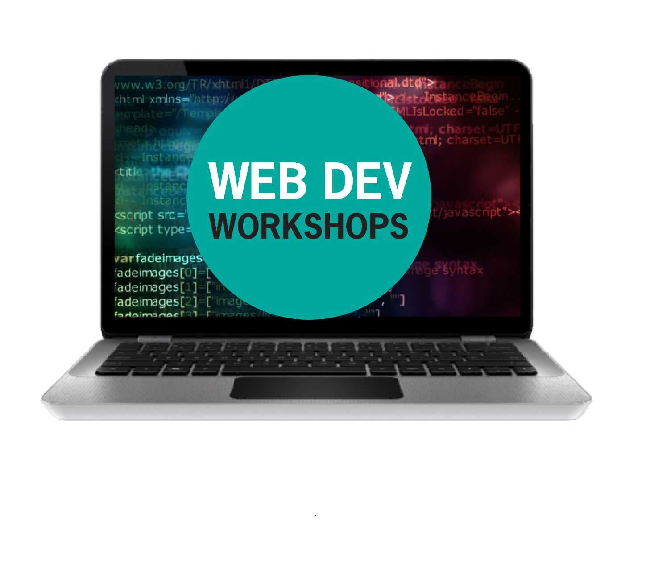
The Internet

Slide 2

Open Sublime Text
Setup
SSID: MakeShop
Password: workshops
Go To: webdev.therobotfoundry.net

Slide 3
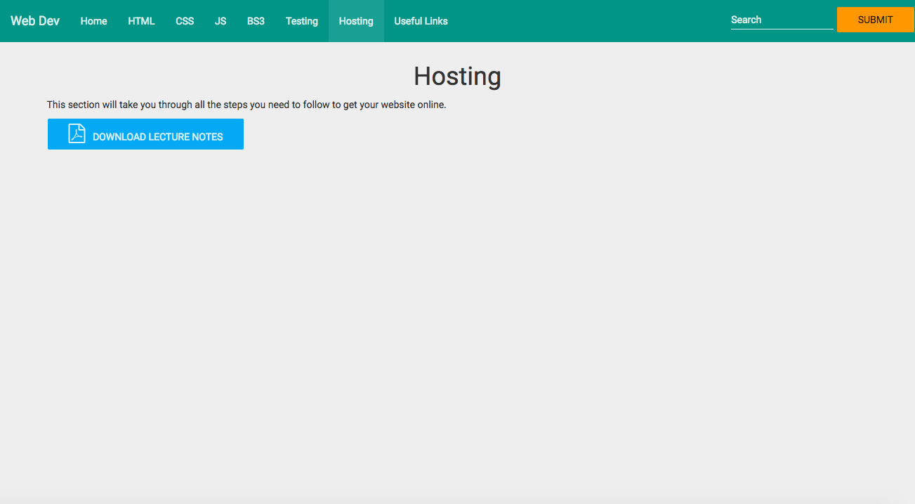
Screenshot of download page

Slide 4
Introducing CSS

Slide 5
Course Overview
Presentation (HTML/CSS)
Interaction (Scripts/Databases)
Hosting

Slide 6
Objective
Your website – online!

Slide 7
Method
Four Challenges:
Set up Github account (free)
Create a repo and gh-pages branch
Upload your website
Repeat

Slide 8
Github
Git: Version control software. Linus Torvalds
Github: A place to upload and manage software projects.

Slide 9
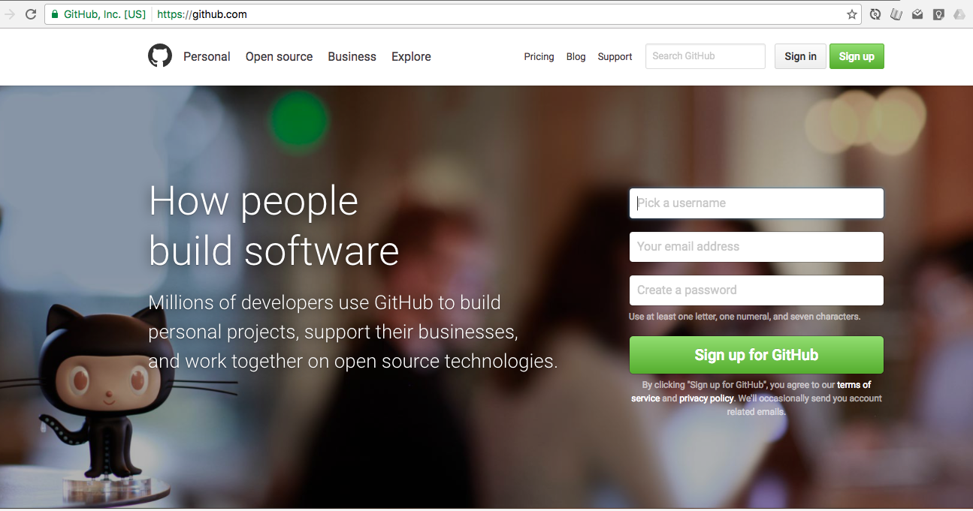
Sign Up

Slide 10
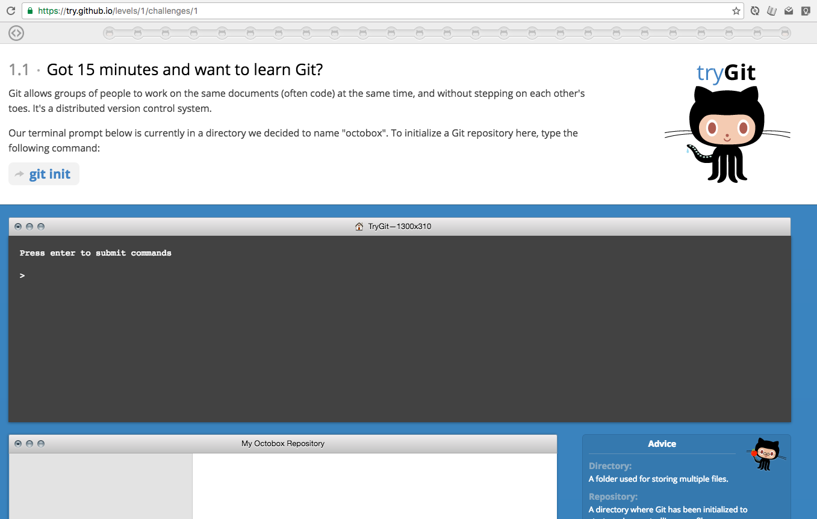
Learn More:
https://try.github.io/

Slide 11
The Internet

Slide 12
History

Slide 13
History

Slide 14
History

Slide 15
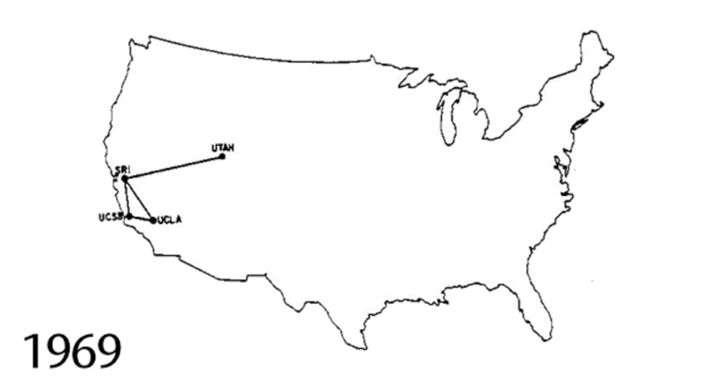
DARPANET

Slide 16
Internet
Vint Cerf
TCP/IP
MCI Mail

Slide 17
World Wide Web
Tim Berners-Lee
HTTP
HTML

Slide 18
Growth

Slide 19
Growth
http://www.submarinecablemap.com/

Slide 20
Back to Ireland

Slide 21
Data Centres

Slide 22
Servers

Slide 23
Challenge
ping
traceroute/tracert

Slide 24
Utilities
http://whatsmyip.org
http://iplocation.net

Slide 25
You.com
1. Register your domain name.
(Brand name/Company name)
2. Get Hosting
(shop/warehouse)

Slide 26
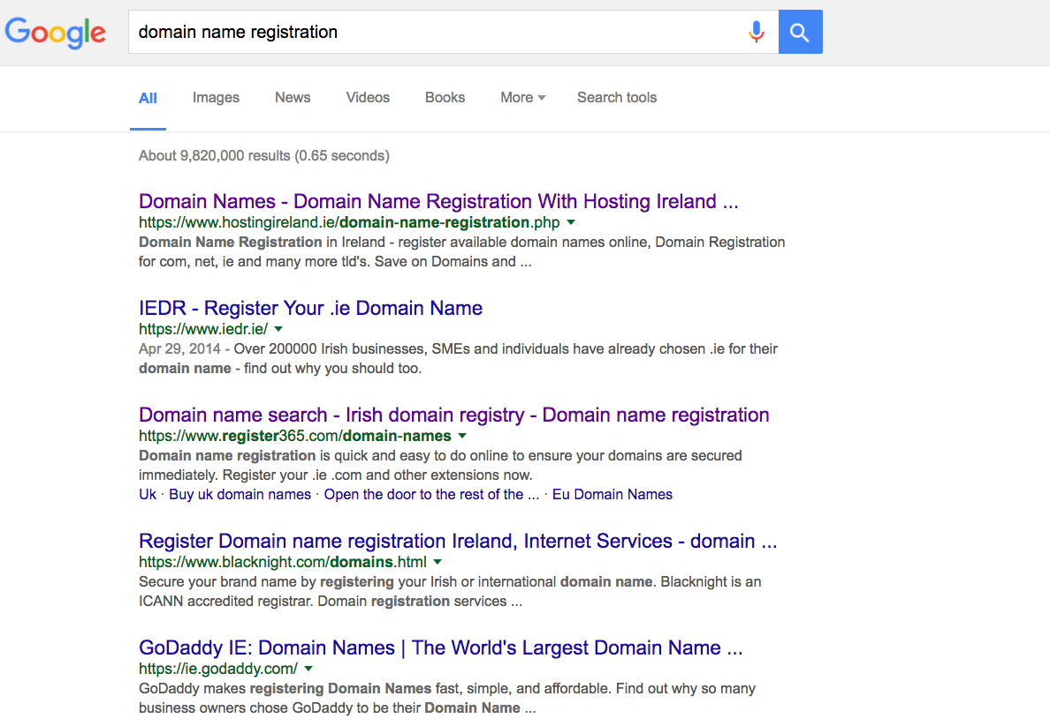
Domain Names

Slide 27
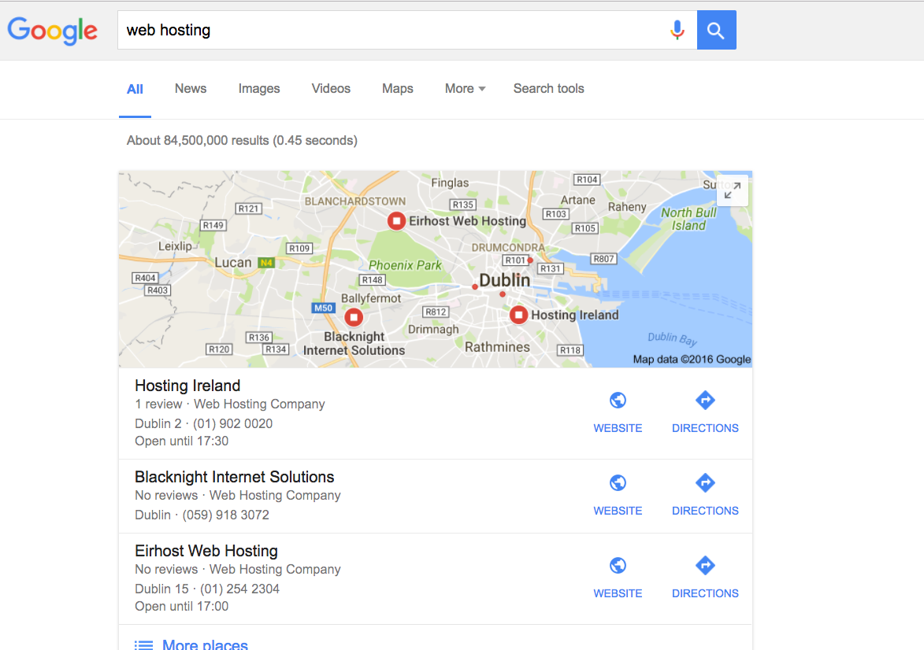
Web Hosts

Slide 28
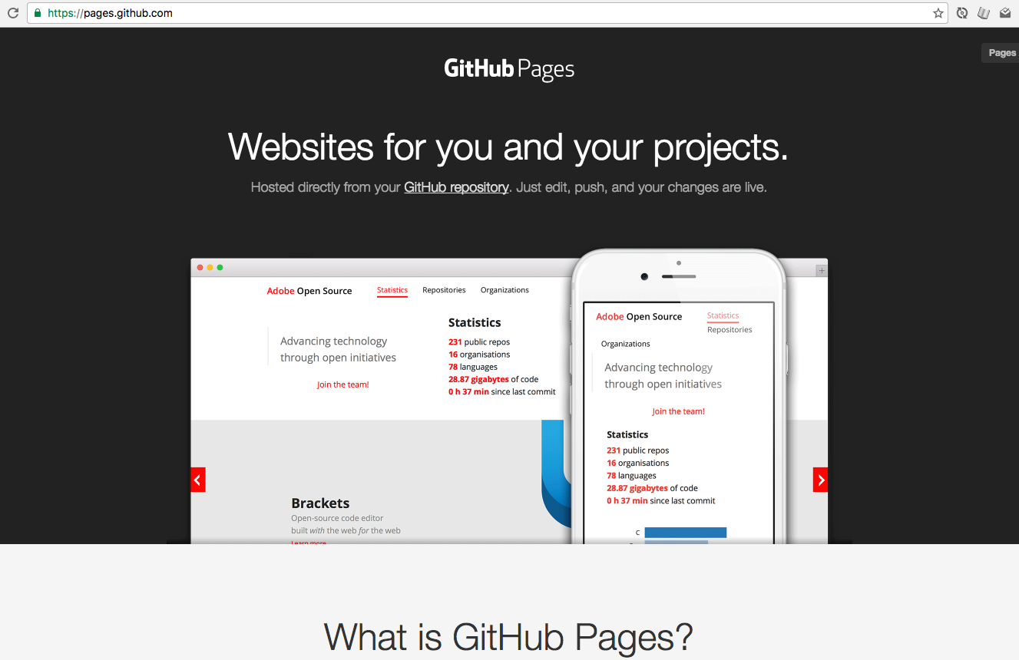
Github Pages

Slide 29
Github Pages
CNAME
https://help.github.com/articles/using-a-custom-domain-with-github-pages/

Slide 30
“Free” Alternatives

Slide 31
Demos
X

